Slide 1
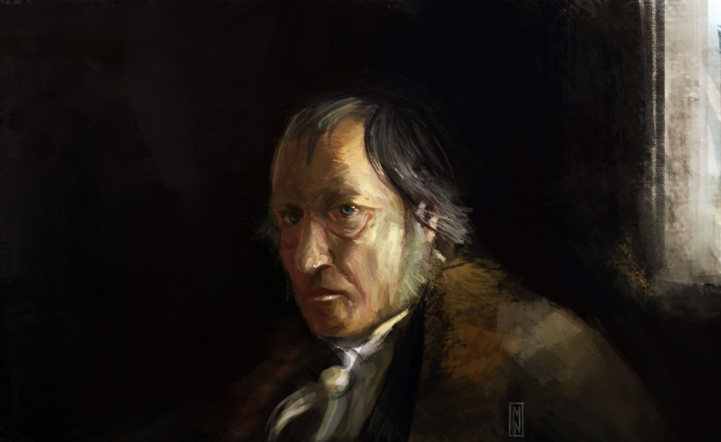
Hegel
Stephanie Spoto
11/23/2021
Monterey Peninsula College
GENT 11/411: Reaction and Revolution (1775-1815)

Slide 2
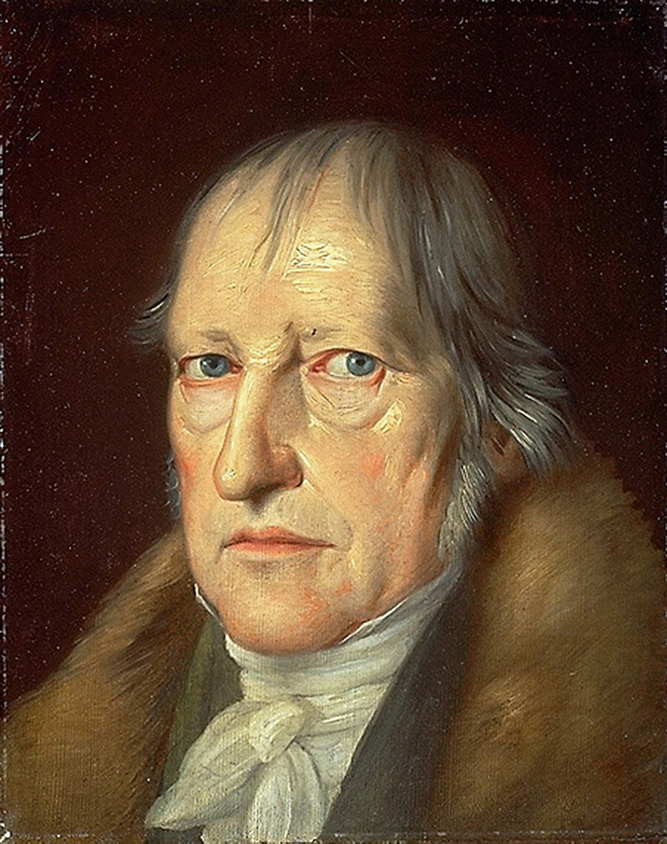
Georg Wilhelm Friedrich Hegel (1770-1831)
German philosopher
Important thinker in German idealism
Primarily influential in the continental tradition of philosopher – becoming increasingly important in analytic tradition as well
In his day, he was widely recognized for his achievements
Hegel is a divisive figure→ but his importance to Western philosophy universally acknowledged.
Portrait by Jakob Schlesinger, 1831

Slide 3
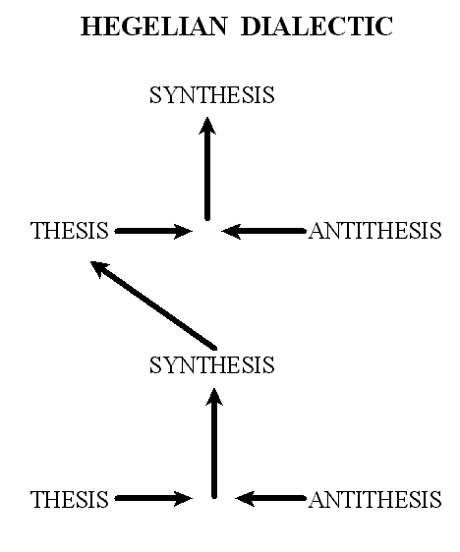
Hegel’s major contributions
One of his most principal achievements: absolute idealism
Dualisms (like mind/nature or subject/object) are overcome
Philosophy of Spirit: integrates psychology, history, religion, art, the state
Master-Slave dialectic: especially important in later French theory and philosophy
Spirit (Geist, also sometimes “mind”): logical understanding of the “sublation” of seemingly contradictory factors
Sublation: being integrated without reduction or elimination
Examples include opposition between immanence and transcendence or necessity and freedom
Seen as the creator of the thesis, antithesis, and synthesis triad

Slide 5
The French Revolution
Hegel drunk a toast to the French Revolution every year
With friends planted the liberty in 1792 in honor of the storming of the Bastille
Might strike some as odd because Hegel is critical of the French Revolution in many of his writings
Thought it enacted abstract, and one-dimensional form of freedom → only wanted to negate and destroy the old order without building new stable institutions to replace it
The French Revolution → critic of all society → ended up destroying the revolutionaries themselves
The Terror and beheading of Robespierre are manifestations of the revolutionaries misguided ideals about freedom and politics

Slide 6
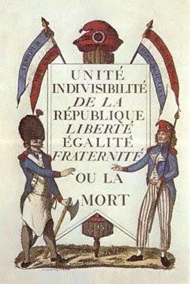
From revolution to constitutional state
Hegel: this is a one-dimensional view of Enlightenment philosophy enacted
An essential moment: the emergence of the principle of freedom, negativity, and complete extraction (important role in this history of humanity)
Wanted to preserve a positive content in the negation of the French Revolution → to raise it to a higher level
Hegel’s political philosophy is an answer to the negativity of the French Revolution
His justification for the rationality of the constitutional state is a way of embodying the principle of freedom in a more complex and developed social home

Slide 7
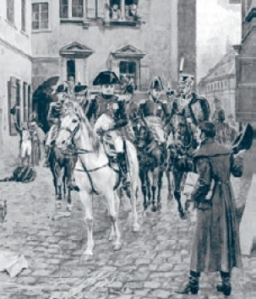
Elements of the Philosophy of Right (1820/1821)
Seen as Hegel’s most advanced and well thought out statements of his social, moral, legal, and political philosophy.
An expansion of ideas and concepts dealt with briefly in the Encyclopedia of the Philosophical Sciences (1817/1827/1830)
Law is the cornerstone of the modern state.
Critiques The Restoration of the Science of the State by Karl Ludwig von Haller
Haller claims that law is superficial → natural law and the right of those who are the most powerful is enough
For Hegel: absence of law is despotism
"Hegel and Napoleon in Jena" (illustration from Harper's Magazine, 1895)

Slide 8
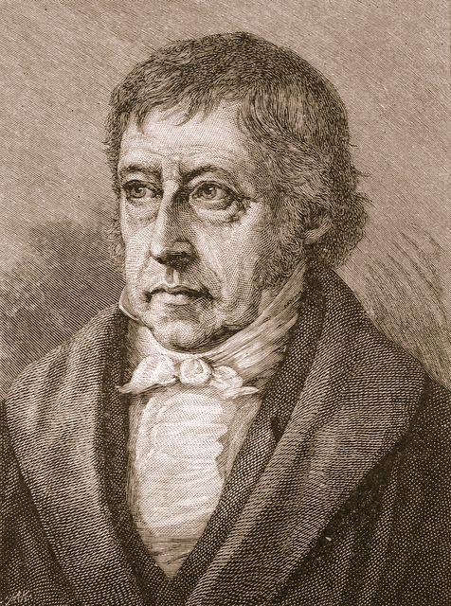
Recht as Right
The Philosophy of Right, as part of the Encyclopedia, deals with the Objective Spirit
Deals with human concerns: social institutions, like marriage, social class, etc. As well as issues of morality, legality, religion, and the economy
Recht → German word often translated as ‘Law’
However, Hegel gives the word much broader meaning
Can now include the good or the just society → this society is “rightful” in its practices, composition, and structure

Slide 9
Scientific Approach to Law
The Idea of right (together with its actualization) is the subject for a philosophical science of right
Inquiry is scientific because it deals with something rational in a systematic way → scientific procedure is laid out by philosophical logic
Spends time exploring the two approaches:
Historical Legal Approach to “Positive law” (Gesetz): mere description; compiling laws as total legal facts
Philosophical approach to the Idea of right (Recht): searches for the inner meaning and vital determinations of right or of law.
Seeking justification for something means studying it conceptually and finding the logic in it → not in looking at it historically

Slide 10
Freedom and Will Universal Will
History/Origins of right relevant to the study of one thing: free will.
Free will is the origin of right → mind/spirit (Geist) objectifies itself in social/political institutions which give expression to freedom
This expression of freedom is both the goal and the substance of right
This goal = ethical life in the state → the unity of the universal and the subjective will
Universal will: freedom as its essence (but separate from the subjective will is only abstract or indeterminate)
Considered separately from subjective will, it is "the element of pure indeterminacy or that pure reflection of the ego into itself which involves the dissipation of every restriction and every content either immediately presented by nature, by needs, desires, and impulses, or given and determined by any means whatever"
Universal will: in the Idea of freedom, the moment where the will is thought of as a state of unconstrained volition, not hindered by circumstances or limitations → a pure form of willing
The modern libertarian view of unrestricted and uncoerced choice and as the absence of restraint
“Negative liberty” → Hobbes

Slide 11
Freedom and Will Subjective Will & Universal Will Unified
Subjective will: activity that incorporates “differentiation, determination, and positing of a determinacy as a content and object”
Meaning that the will is not only unconstrained in action → but can actually manifest the doing of certain things, like through expertise or talent (“positive freedom”)
Maintaining a distinction between the subjective and universal wills in the unity (identity-in-difference) is what helps produce the rational self-determination of the self → and understanding of state as a whole
Freedom as self-determination = unity in difference of subjective and universal will (either as individual or group)
Negative self-relation of freedom: the subordination of natural impulses and desires to purpose, goals, and self-reflection → requires commitment to rational principles

Slide 12
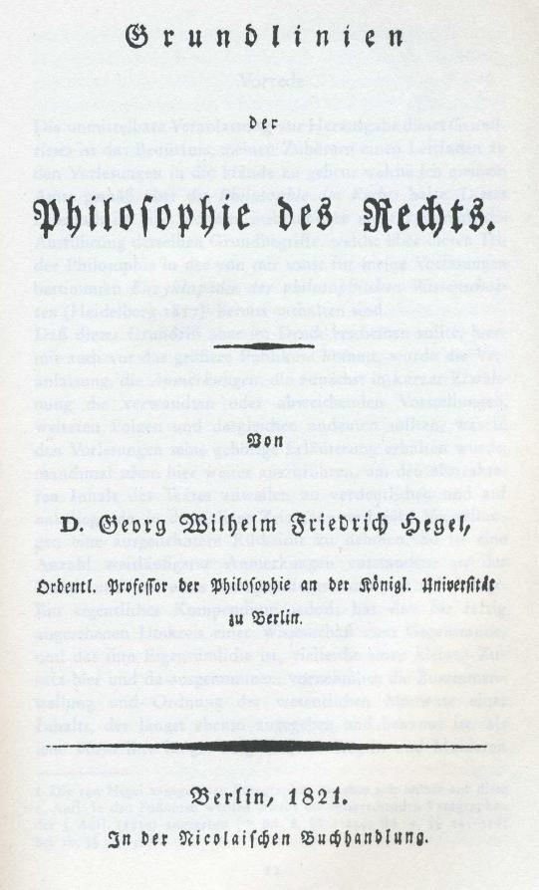
Free Will and Participation
Free will is a central concept to The Philosophy of Right.
Hegel argues that free will can only realize itself in the complex social relations of contracts, property rights and relations, moral commitments, the legal system, the polity, etc.
In order to be truly free, a person must participate in all of these different arenas of the life of the state.

Slide 13
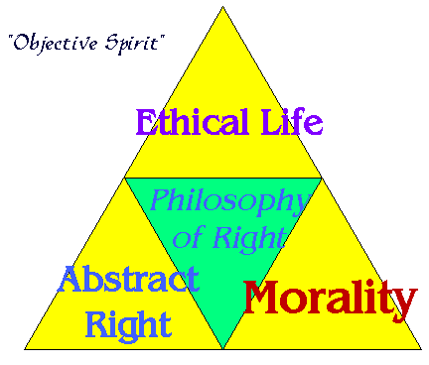
The Three Spheres of Right
The majority of the book focuses on discussions of the Three Spheres of Right
Abstract Right (Recht): “non-interference” is a way of respecting others. This alone is not enough.
Morality (Moralität): Human reflect on their own being and subjectivity → see their own subjectivity and therefore the subjectivity of others → necessary in order to respect them
Ethical Life (Sittlichkeit): Integrates subjective/individual feelings and universal concepts of right → here is the realm of Hegel’s exploration of the family, society, and the state.

Slide 14
Subsumption of the State under World History
While creating these layers of right (with the ethical life being related to the state), the state is subsumed by history
World history is a higher totality → individual states arise in this totality, they have conflict and then they eventually fall
History moving on a course towards ever-increasing actualization of freedom → the telos of history
Each historical era remedies the failures of earlier ones
However, history has not yet been able to tackle certain vital tasks associated with the state’s inner organization

